Slide 1
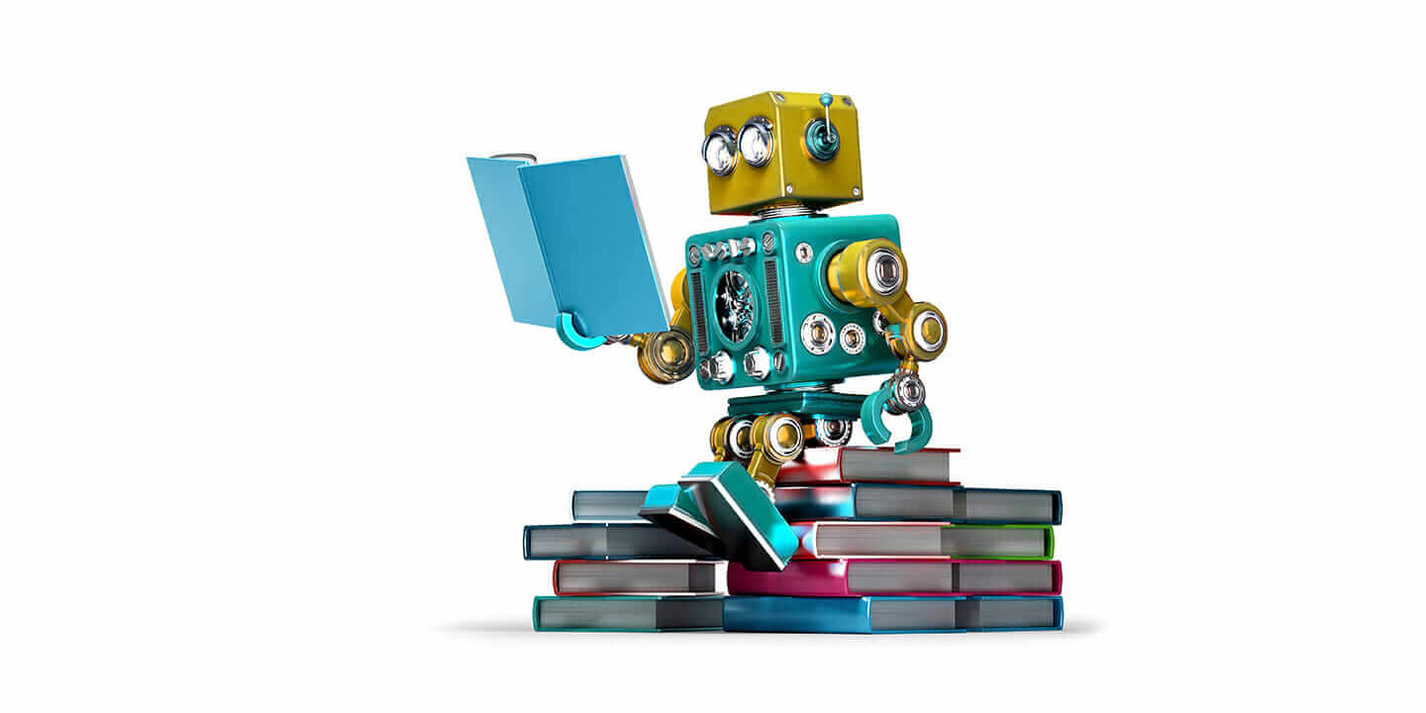

MACHINE LEARNING
LAB1
贾艳红 Jana
Email: jiayh@mail.sustech.edu.cn
王大兴
Email: wangdx3@mail.sustech.edu.cn

Slide 2
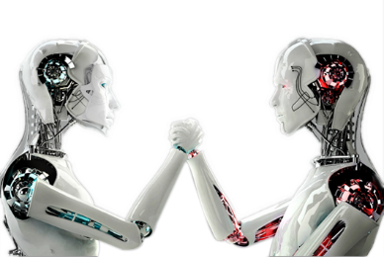
PART ONE
Lab Introduction

Slide 3

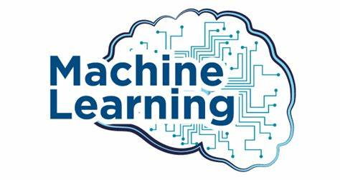
Class Schedule
Lab01(H): Wednesday 14:00 pm -15:50 pm Teaching Building III Room 504
Lab01: Tuesday 14:00 pm -15:50 pm Teaching Building III Room 511
Lab02: Wednesday 16:20 pm -18:10 pm Teaching Building III Room 510
Lab03: Friday 14:00 pm -15:50 pm Teaching Building III Room 504
Grading policy
Final Exam (in-class): |  |  | 20% | Midterm Exam(take-home): 10%
Assignments (8~12 times): |  |  | 20% | Quizzes(<=10 times): 10%
LAB Task: |  |  | 15% | Final Projects (4 per group): 20%
LAB attendance: |  |  | 5%
90~93: | A- | 94~97: | A | 98~100: | A+
80~82: | B- | 83~86: | B | 87~89: | B+
70~72: | C- | 73~76: | C | 77~79: | C+
60~62: | D- | 63~66: | D | 67~69: | D+

Slide 4
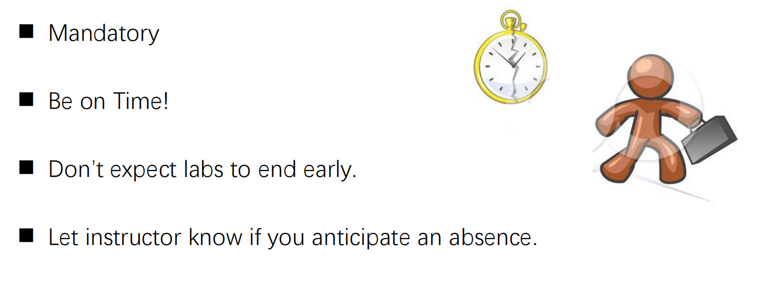
Attendance

Slide 5
Textbook and Lab Notes
Textbooks:
Pattern Recognition and Machine Learning, by Christopher M. Bishop, 2006 Springer
Machine Learning in Action, by Peter Harrington, 2012, Manning
Hands-On Machine Learning with Scikit-Learn, Keras, and TensorFlow
Other books:
1 机器学习，周志华
2 Dive in Deep Learning, by Aston zhang, Zachary C.Lipton, Mu Li, and Alexander J.Smola
3 Reinforcement Learning: An Introduction, by Richard S. Sutton
4 the Elements of Statistical Learning Data Mining, Inference, and Prediction
Paper reading:
Ghahramani Z. Probabilistic machine learning and artificial intelligence, Nature, 2015
Lecun Y, Bengio Y, Hinton G. Deep learning, Nature, 2015
Littman M L. Reinforcement learning improves behavior from evaluative feedback, Nature, 2015

Slide 6
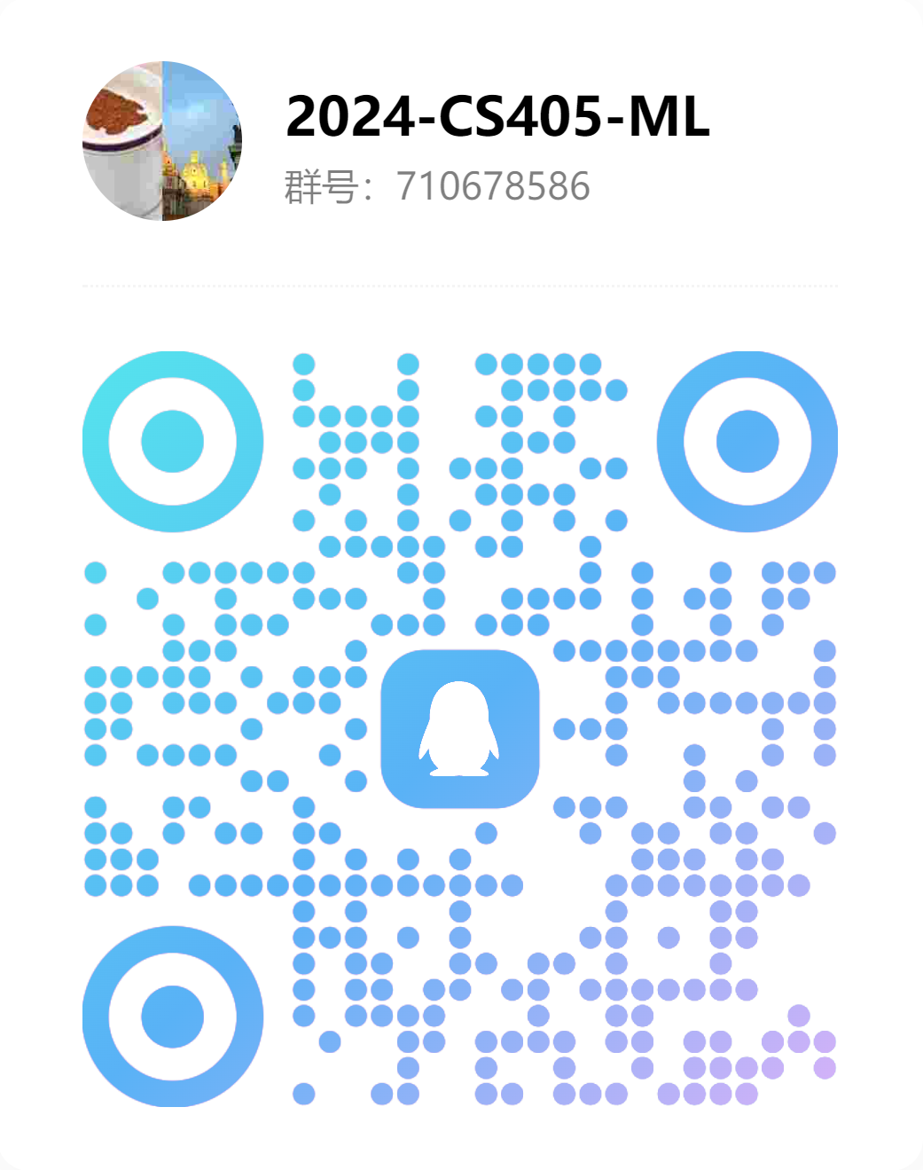
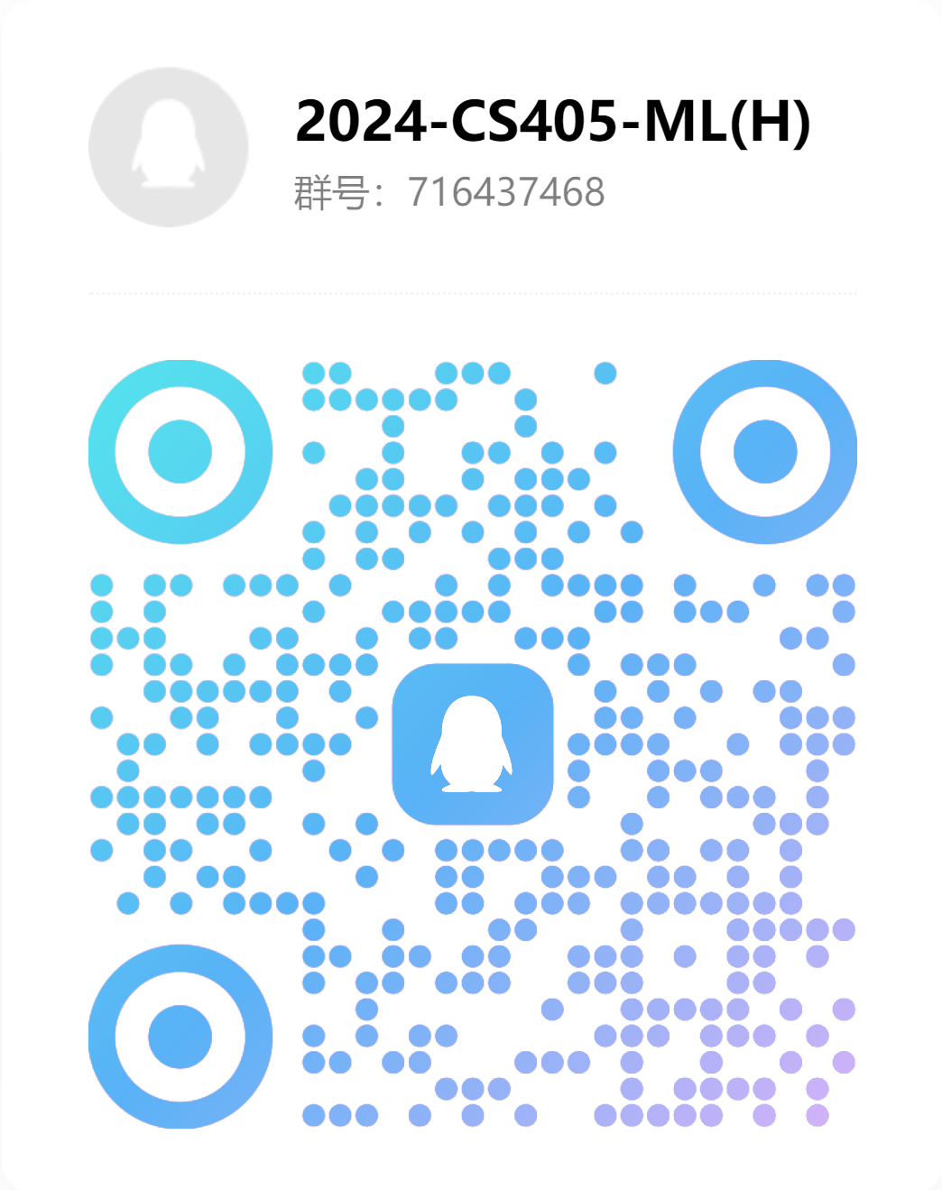
Other considerations
TA:
高瑞，王宇杰，杨凌宇，蔡灿杰，周子睿，加泽瑄，周宏宇
QQ Group:

Slide 7
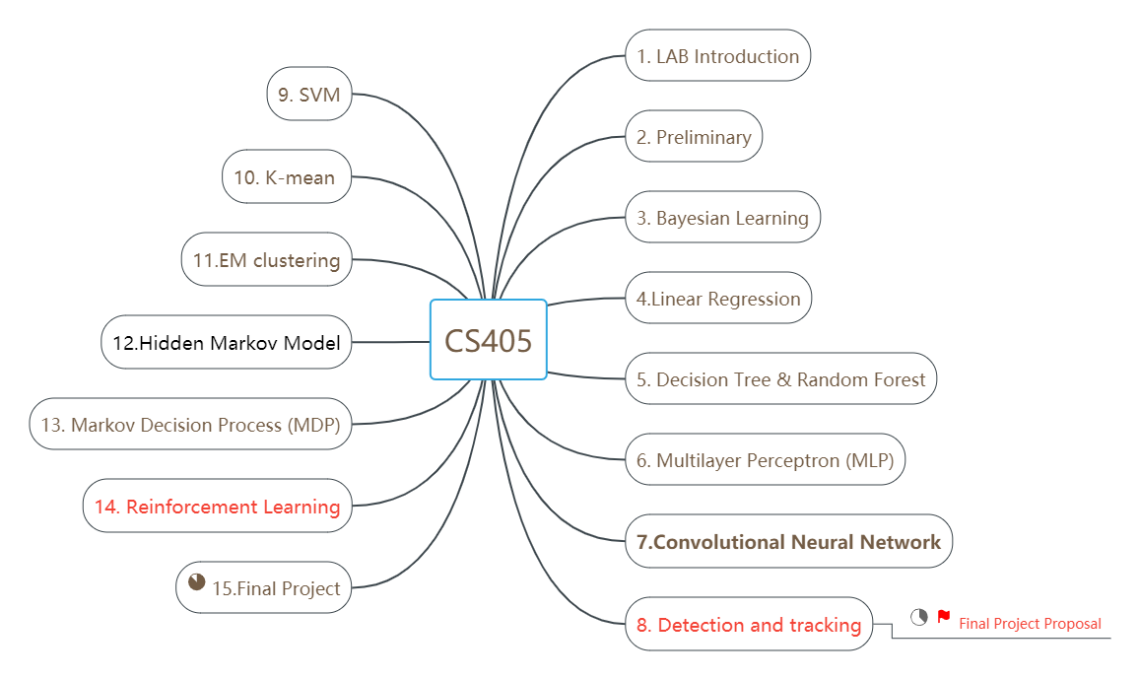
Lab Schedule

Slide 8
Final Projects
Object detection and tracking
GAN for self driving data augmentation
CARLA Simulator
Traffic sign & lane
Vehicle road cooperative
RL for autonomous driving simulator
Semantic segmentation

Slide 9
Lab Report & Grading Guidelines
Lab report
■ Follow the lab instructions
■ Testing the algorithms and discuss your observations [25%]
■ Develop new algorithms (bonus)
■ Describe your methods (bonus)
■ Validating the algorithms and discuss your observations[75%]
we will deduct scores according to this rule, but we will not strictly follow it all the time. In some cases, we may decide to detract more or less points based on the perceived gravity of the mistakes.

Slide 10
Final Project & Grading Guidelines
Proposal (with Presentation) (2~4 people) [20%]
Midterm report [10%]
Final Report(with Presentation and Demos [70%]
Abstract (motivation, method, novelties, validation) [10%]
Introduction (Background, Motivation, Challenges, Rationale, Contributions) [15%]
Existing Methods of Related Work, Novelties of This Work [15%]
System Setup, Problem Statement [10%]
Proposed Method [15%]
Results (Experiment platform, experiment setup, results) [10%]
Discussion (Comparison and analysis, speed, accuracy, robustness, strengths and limits) [15%]
Conclusion (Main method, major results, future work) [05%]
References [05%]
we will deduct scores according to this rule, but we will not strictly follow it all the time. In some cases, we may decide to detract more or less points based on the perceived gravity of the mistakes.

Slide 11
Group
CS405_Project组队
非图灵班：https://docs.qq.com/sheet/DQUxhdFFSc25wYmFt?tab=BB08J2
图灵班： https://docs.qq.com/sheet/DQUxhdFFSc25wYmFt?tab=fkn9ut
Please open the Shared Exel, and complete the grouping. DDL is week8.

Slide 12
Websites
Lab Tutotial web sites
http://scikit-learn.org/stable/tutorial/basic/tutorial.html
https://pythonprogramming.net/python-fundamental-tutorials/
https://pythonprogramming.net/data-analysis-tutorials/
https://pythonprogramming.net/robotics-tutorials/
http://prml.github.io/
https://scikit-learn.org/dev/user_guide.html

Slide 13
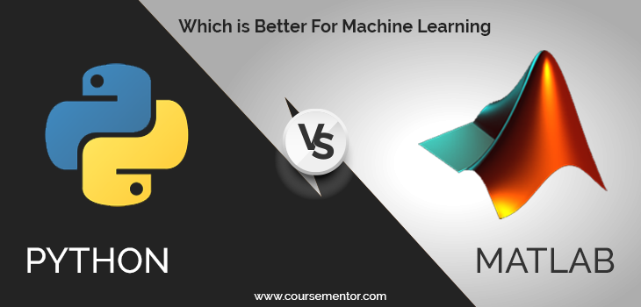
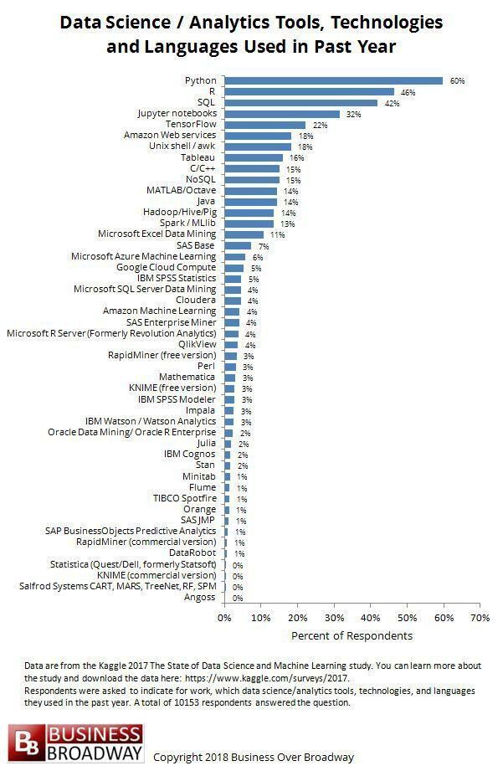
Which Programming language is popular for ML?

Slide 14
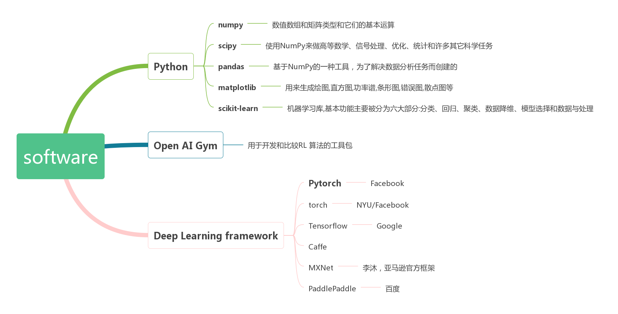
software

Slide 15
PART TWO
Prepare the development
environmentIntroduction

Slide 16
Prepare the development env intro
Install python + vscode
See lab meterial.
2. Install essential libraries for Machine Learning in Python
Numpy，a package with support for mathematical operations on multidimensional data—was the most imported package, used in nearly three-quarters of machine learning and data science projects. （https://numpy.org/）
scipy, a package for scientific computation.（https://www.scipy.org/）
pandas, a very popular library,it can easily fetch data from different sources like SQL databases, CSV, Excel, JSON files and manipulate the data to perform operations on it. （https://pandas.pydata.org/）
matplotlib, a visualization library.（https://matplotlib.org/）
scikit-learn ,Scikit-learn is one the most popular ML libraries. It supports many supervised and unsupervised learning algorithms. Examples include linear and logistic regressions, decision trees, clustering, k-means and so on.For a novice in ML, Scikit-learn is a more-than-sufficient tool to work with, until you start implementing more complex algorithms.（https://scikit-learn.org/stable/index.html）

Slide 17
PART THREE
Lab Task

Slide 18
Lab Task
Install and configure your development environment on your own computer.
Create new Python environment. Run HelloWorld.py and standardplot.py in this environment.
Finish Lab exercise.

Slide 19
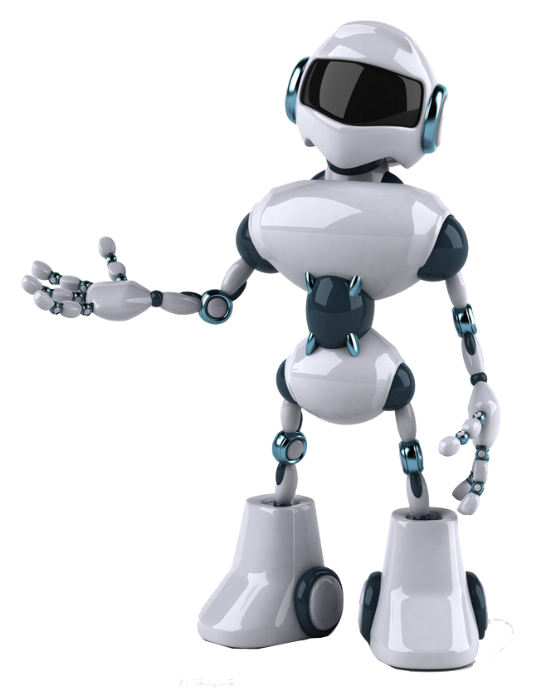
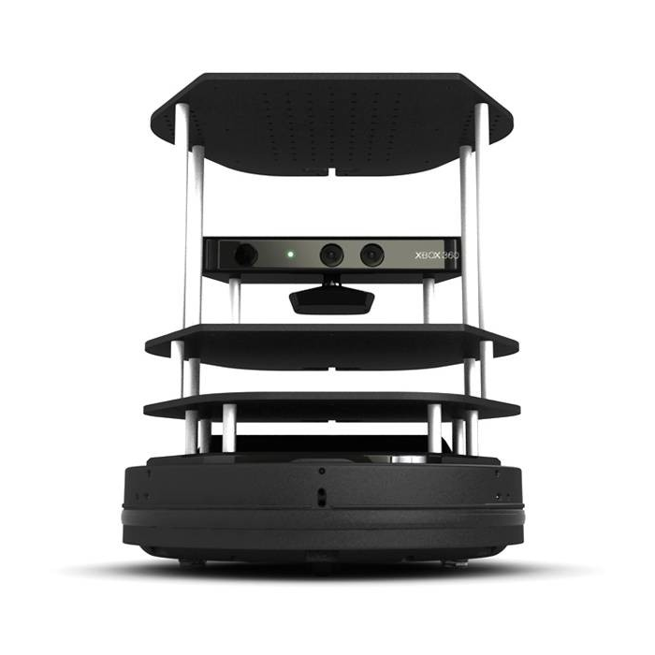

Thanks
贾艳红 Jana
Email:jiayh@mail.sustech.edu.cn
王大兴
Email: wangdx3@mail.sustech.edu.cn

